Slide 1
Detecting Cyberbullying in Tweets using Classification
CS4210: Grecia Alvarado, Christopher Koepke, Abdur Rahman, Sean Ta

Slide 2
Overview
Problem Statement
Dataset/Preprocessing
01
03
Visualization
Modeling/Analysis
02
04
Introduction to our problem and motivation
Dataset overview and data cleaning to prepare for our models
Quick view of most frequent words through word clouds and n-grams
Multinomial Naive Bayes, Random Forest, Logistic Regression

Slide 3

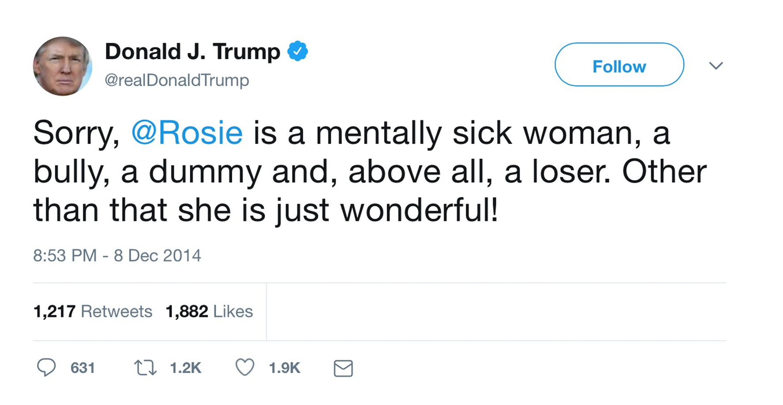
Problem Statement
Twitter is a popular social media platform with a more conversational approach compared to others and has become a breeding ground for cyberbullying.
Cyberbullying can be further broken down into the subcategories of gender, religion, age, ethnicity, and other.
Addressable Problems:
Tedious categorization for human moderators
Necessity for quick response to harmful tweets
What kind of language can be considered cyberbullying?
Notes:
Grecia

Slide 4
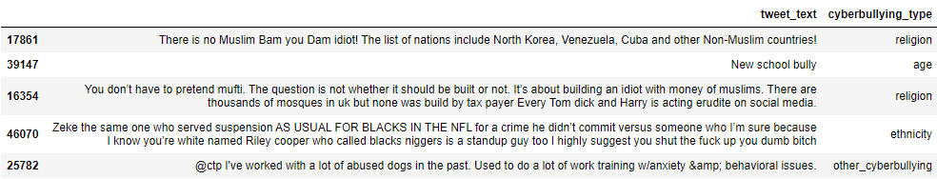
Dataset
Our dataset contains 46,017 records/tweets.
Each record is classified as either a certain type of cyberbullying or not.
We removed any duplicate tweets, of which there were a total of 1675 duplicate records.
In our opinion, we have a balanced class distribution.
Class Distribution:
Not cyberbullying - 7937
Age - 7992
Ethnicity - 7952
Gender - 7898
Religion - 7995
Other - 6243
Sample of raw data
Notes:
Abdur:
We got our dataset from Kaggle. The dataset contains 46,017 tweets. Each of those tweets are classified as either not cyberbullying or as some specific category of cyberbullying. So each record in the dataset contains a tweet and its classification. We checked for missing values in the dataset and found none. We also checked for any duplicate records and removed 1675 of them.
So here is the list of all the classes in our dataset. We have not cyberbullying at the top and then we have age, ethnicity, gender, religion, and other as the different categories of cyberbullying. When it comes to the class distribution in our dataset, the number of tweets that fall under every category is very similar at around 7900, with the only exception being the other cyberbullying class. Even then, the other cyberbullying class contains around only 20% less records than the other classes.
So here are some samples of raw data from our dataset. We have the tweet text here and its classified bullying type here.

Slide 5
Preprocessing
We performed text cleaning by removing any unwanted text from tweets:
Emojis
URLs
Digits & underscores
Special characters
Single letters/characters
Stop words
We converted every character to lowercase and lemmatized every word.
We also transformed text to numerical values using TF-IDF Vectorizer to fit into our ML models.
Notes:
Abdur
When we started to do preprocessing on our dataset, we first started by checking what things we could remove from tweets. So we went through all the tweets in our dataset and remove any emojis, urls, digits & underscores, special characters, single letter words or characters, and any stop words.
After that we lowercased all of the tweets and performed lemmatization on all of the words in every tweet.
After we finished that step, we used that cleaned text data to make word clouds and n-grams to get a general view of what the dataset is like and We will talk about those in the next slides
Then for our final step of preprocessing, we converted all text in the tweets to numbers using ti-idf vectorization so we can finally feed it to our Machine learning models.

Slide 6
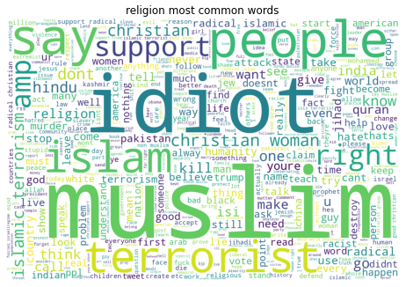
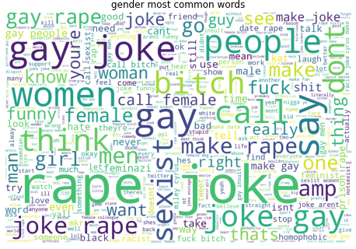
Word Clouds
World Cloud: visual representation of textual data, size of word represents its importance/frequency
generated word clouds for all classes: gender, religion, age, ethnicity, not cyberbullying, other cyberbullying
max: 500 words
Notes:
Grecia
Things to talk about on this slide:
Define word cloud
Talk about how we generated word clouds for all our classes, but only showed religion and gender as an example
Max 500 words for each word cloud
Quick analysis of word clouds, and how it makes sense that the top frequent words in tweets related to religion would have ‘muslim, ‘islam’, etc

Slide 7
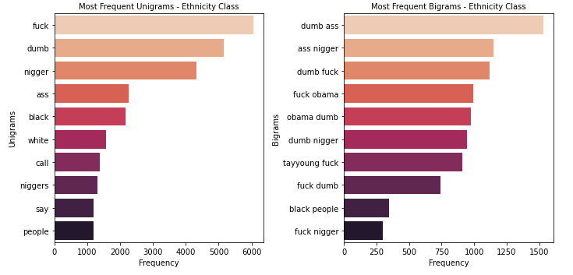
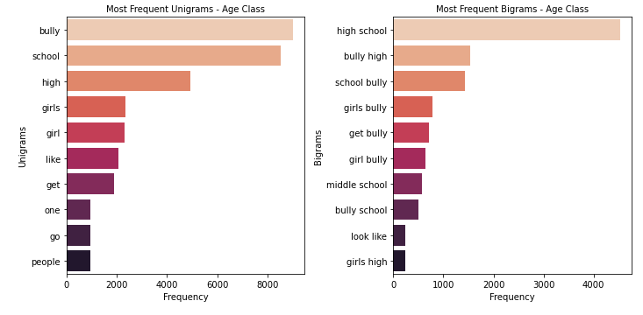
N-Grams
N-Grams: sequence of N-words
We generated unigrams and bigrams for each type of cyberbullying using the CountVectorizer function from NLTK library
This allows us to quickly identify the most common unigrams (single word) and bigrams (set of 2 words)
Ethnicity
Age
Notes:
Grecia
Things to talk about on this slide:
Define n-grams
Talk about how we generated word clouds for all our classes, but only showed ethnicity and age as an example
Talk about how unigrams are helpful, quickly identifies the most frequent unigrams and bigrams for tweets in that specific class
Quick analysis of n-grams, and how it makes sense that the top frequent words in tweets related to ethnicity would have ‘black’,’white’, etc
How it makes sense that the top unigrams and bigrams for age tweets have ‘school’, ‘high school’ ‘ middle school’ ‘bully’

Slide 8
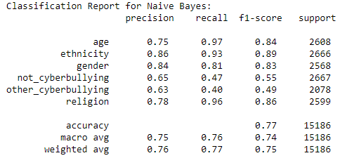
Multinomial Naive Bayes
Popular Bayesian learning approach to Natural Language Processing (NLP).
It is used to predict the tag of a piece text by calculating the probability of each tag and outputting the tag with the highest probability.
During our testing, we were able to achieve an accuracy of 77%, and a weighted recall average of 77%.
Our highest F1-scores for this model are ‘age,’ ‘ethnicity,’ ‘gender,’and ‘religion’.
Notes:
Chris
Explain that for all our 3 models we are performing multi-class classification
Explain results of naive bayes model

Slide 9
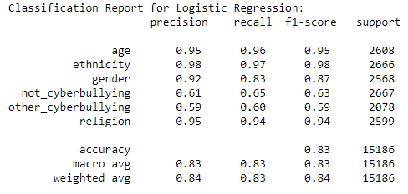
Logistic Regression
This algorithm finds the probability of a label by calculating the weight of a feature (word in our case) to its predicted label and updates the weights for each iteration until the weights of each feature stabilizes.
Our testing achieved an accuracy of 83%, and a weighted average recall of 83%.
Our highest F1-scores for this model are ‘age,’ ‘ethnicity,’ ‘gender,’ and ‘religion’.
Notes:
Chris
Talk about results for logistic regression

Slide 10
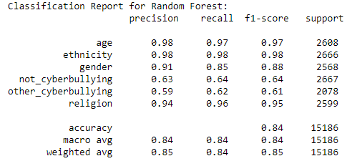
Random Forest
As we know, this is an ensemble of different decision tree algorithms.
We were able to achieve an accuracy of 84%, and a weighted average recall of 84%.
Highest F1-scores for this model are ‘age’, ‘ethnicity’, ‘gender’, and ‘religion’.
Our Random Forest model will be used for deployment, if we were requested to build a model for Twitter.
Notes:
Chris
Talk about results for random forest
Talk about it had the highest accuracy and this will be the model chosen for deployment.

Slide 11
Conclusion
The accuracy of all three models tested were greater than 75%, with our highest being 84%.
We did perform a grid search for all three models using various hyperparameters, but they did not produce higher accuracies, thus we used the default parameters in our final models.
Our models might not seem as being highly accurate, when thought about in the context of healthcare; where accuracy and recall are highly important.
We are not trying to correctly guess a medical diagnosis, or predict future stock prices, but are instead focused on preventing the possible harm done to individual(s) / group(s) through cyber bullying. We would use these models as a tool to help Twitter moderators achieve these goals, quicker.
THANK YOU FOR LISTENING TO OUR PRESENTATION!!!
Any Questions?
Notes:
Grecia

